Slide 1
CSC 112: Computer Operating Systems Lecture XX TODO
Department of Computer Science,
Hofstra University
Acknowledgement: Lecture slides based on UC Berkeley CS 162: Operating Systems and System Programming

Slide 2
Outlines
Semaphore
Semaphore operations
Binary Semaphore
Semaphore for ordering
Semaphore for P/C
Deadlock
Semaphore for P/C without deadlock

Slide 3
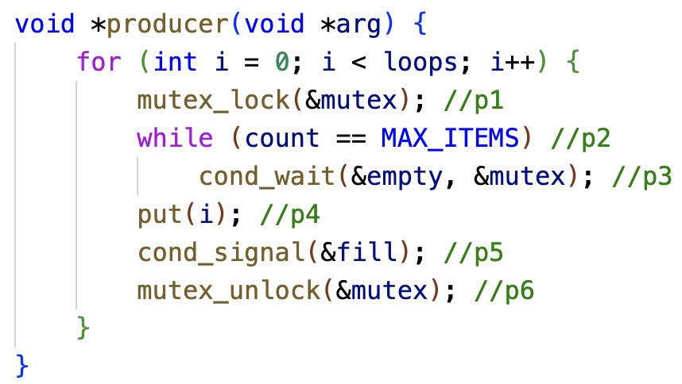
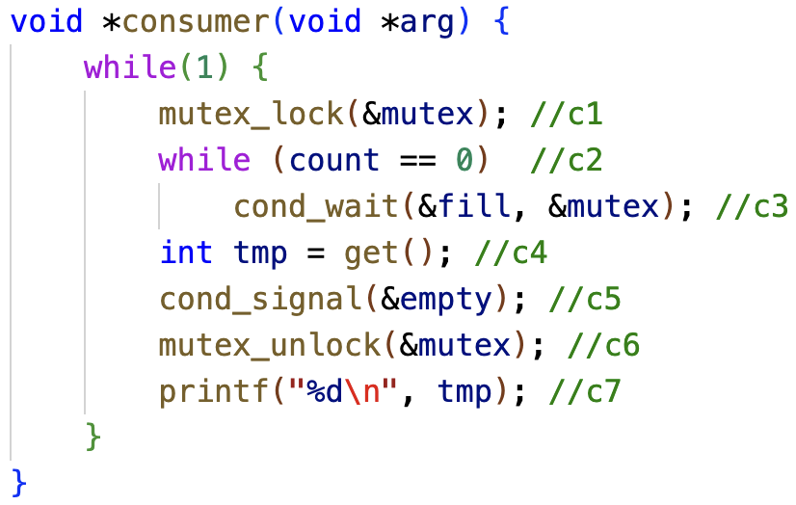
Recap
Producer/Consumer Problem
Condition Variable for Producer/Consumer Problem
Two CVs and while loop

Slide 4
Semaphores
An object with an integer value
Introduced by E. W. Dijkstra
Manipulate with two routines
sem_wait(s) P(s) down(s)
sem_post(s) V(s) up(s)
Motivation: Avoid busy waiting by blocking a process execution until some condition is satisfied

Slide 5
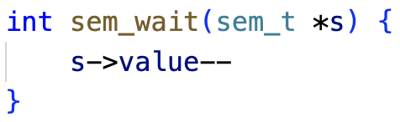
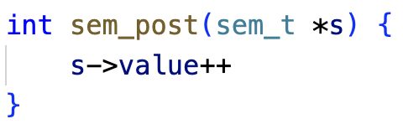
Semaphore Operations
Wait or test
Decrements sem value by 1. Waits if value of sem is <0
Signal or Post:
Increments sem value by 1. Then wake a single waiter if exists
;
;

Slide 6
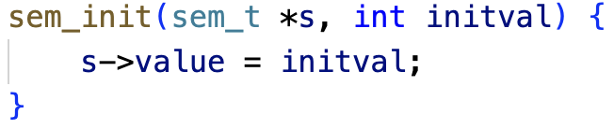
Semaphore Operations
Initialization determines behavior of semaphore operations
Value of the semaphore, when negative = the number of waiting threads
Notes:
sem_init(&s, 0, 1);
A simple version, the real implementation has 3 arguments

Slide 7
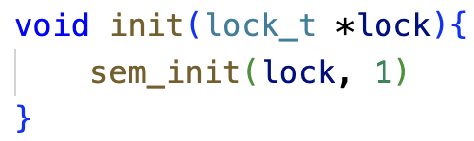
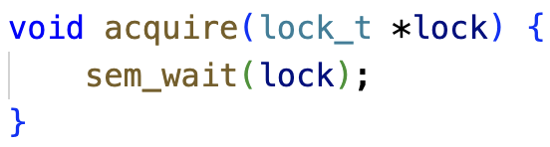
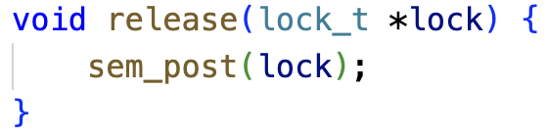
Binary Semaphore
Binary Semaphore is a lock

Slide 8
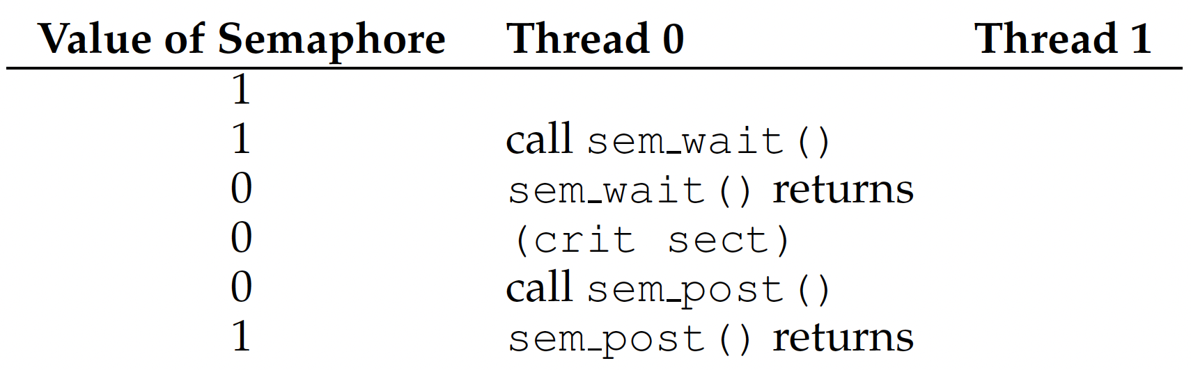
Binary Semaphore
Single thread using a binary semaphore

Slide 9
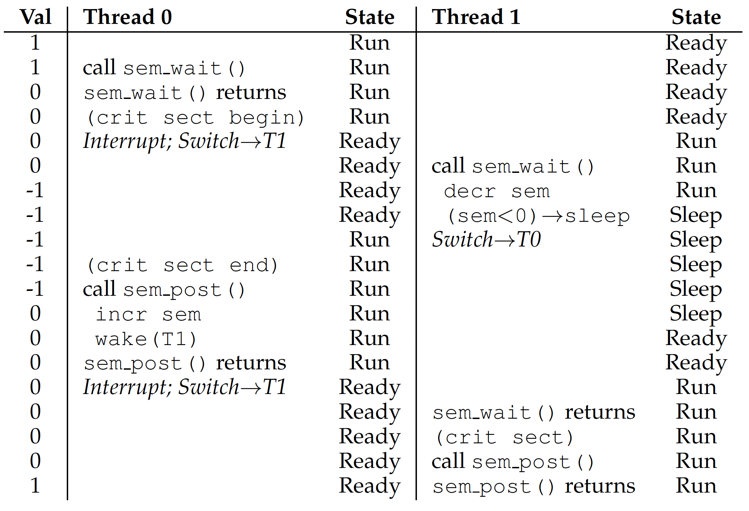
Binary Semaphore
Two threads using a binary semaphore

Slide 10
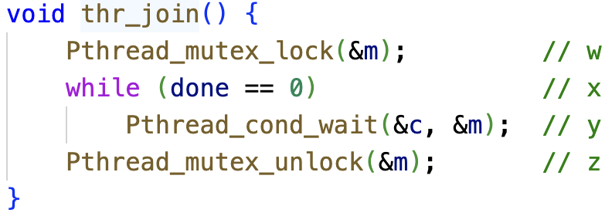
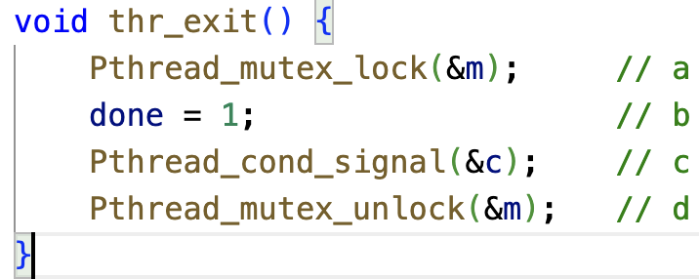
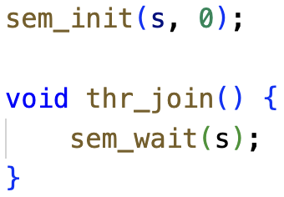
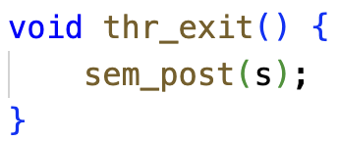
Semaphore for Ordering
Parent waits for child to complete
Condition variable

Slide 11
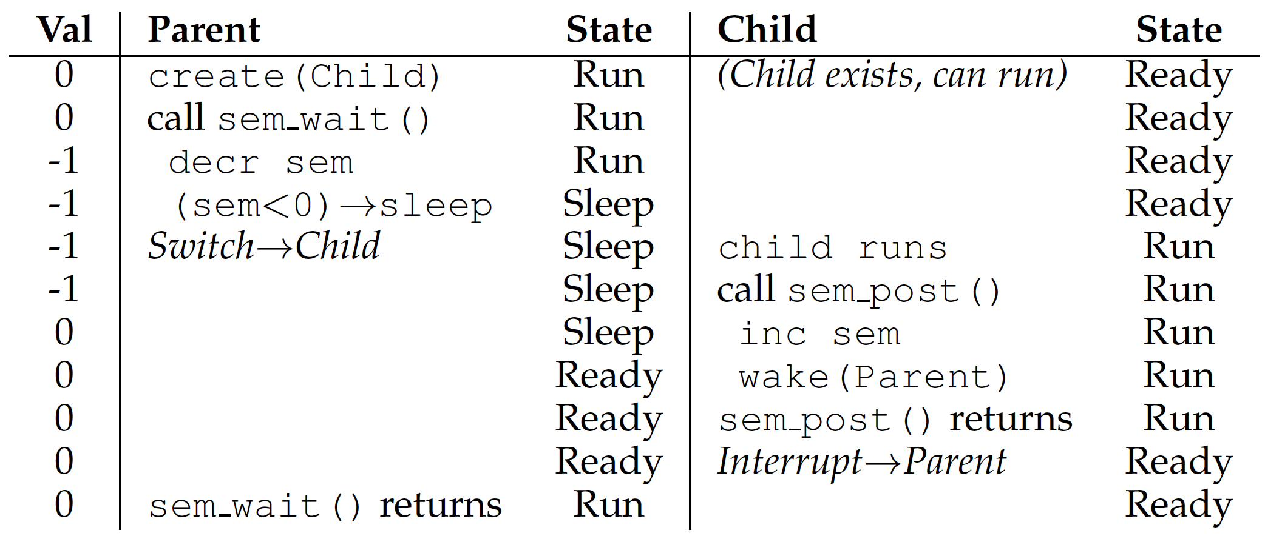
Semaphore for Ordering
Case 1

Slide 12
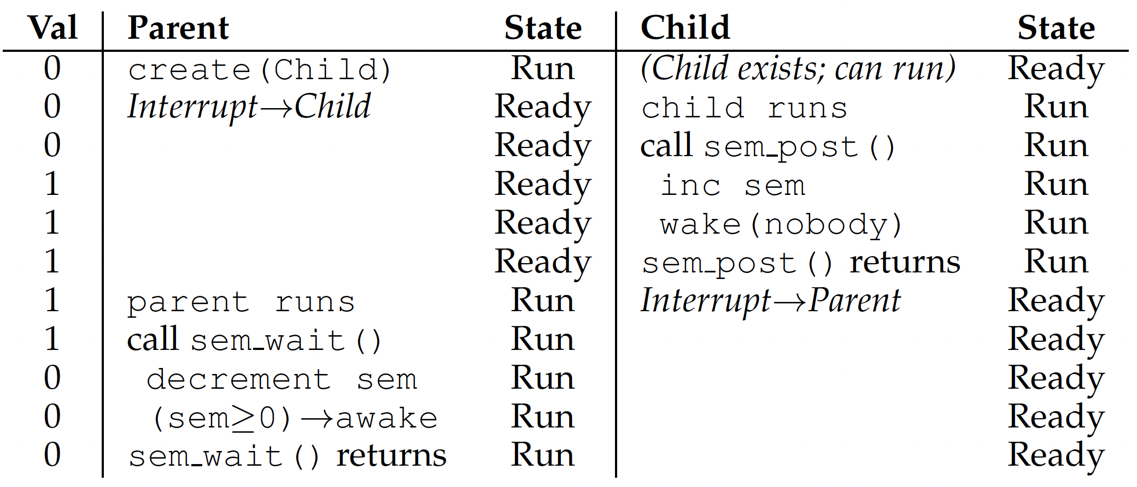
Semaphore for Ordering
Case 2

Slide 13
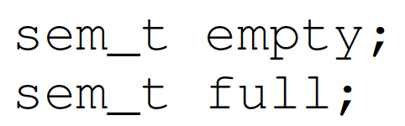
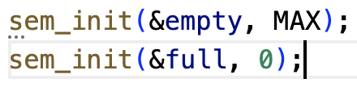
Semaphore for P/C
Shared data:
Initialization:
producer
consumer

Slide 14
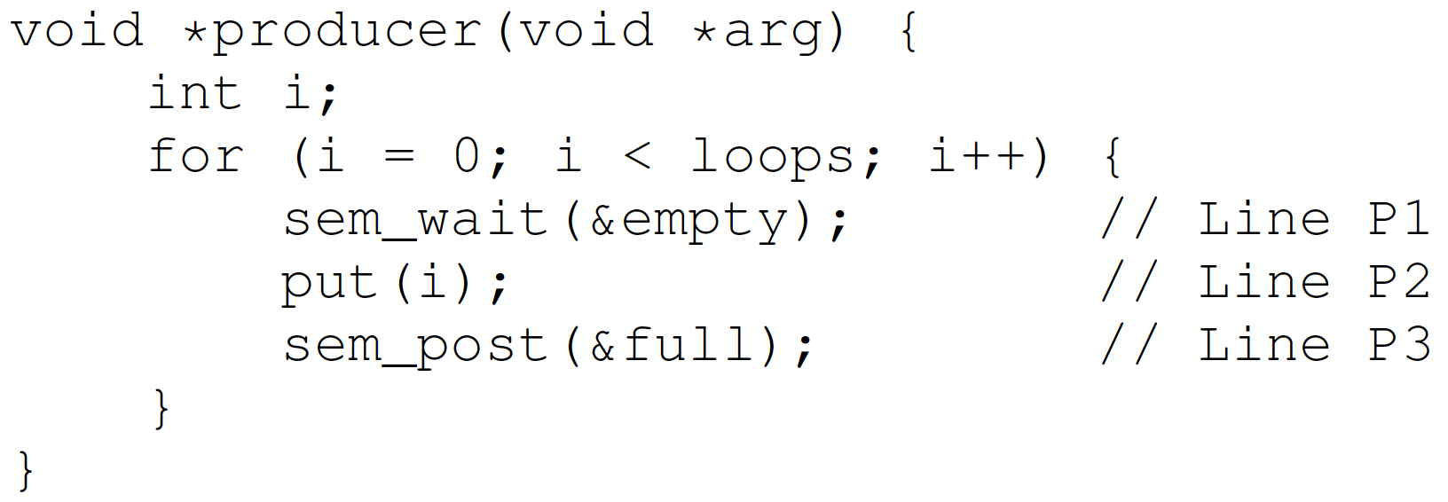
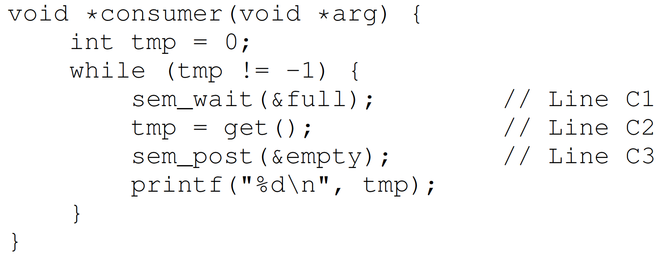
Semaphore for P/C
MAX=1

Slide 15
Semaphore for P/C
MAX > 1
Race condition

Slide 16
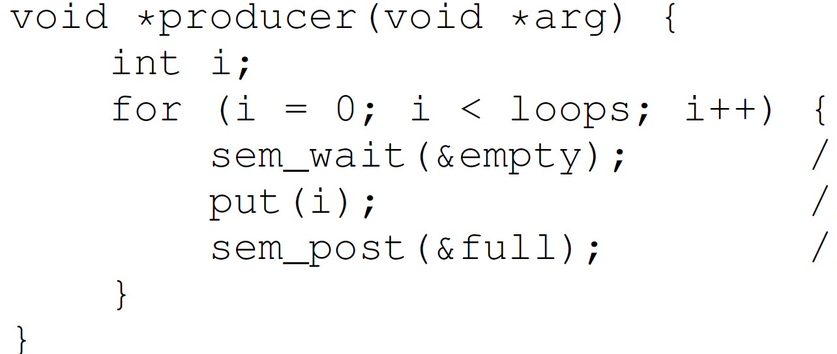
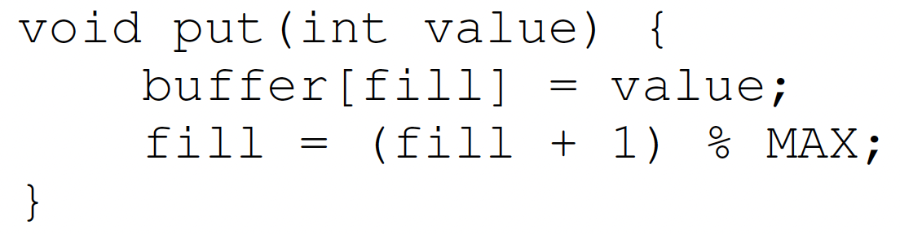
Semaphore for P/C
2 producers
Empty = 9
MAX=10
Producer 1
Producer 2

Slide 17
Semaphore for P/C
2 producers
Empty = 8
Producer 1
Producer 2
Interrupted
Same fill, overwrite

Slide 18
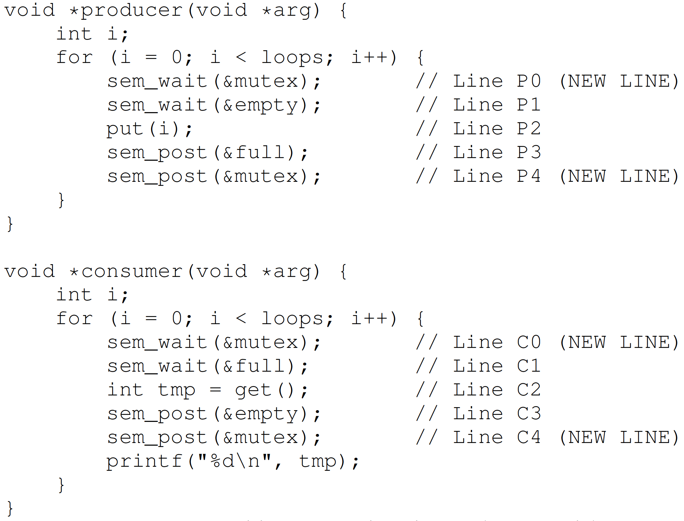
Semaphore for P/C – Mutex
Add a mutex lock

Slide 19
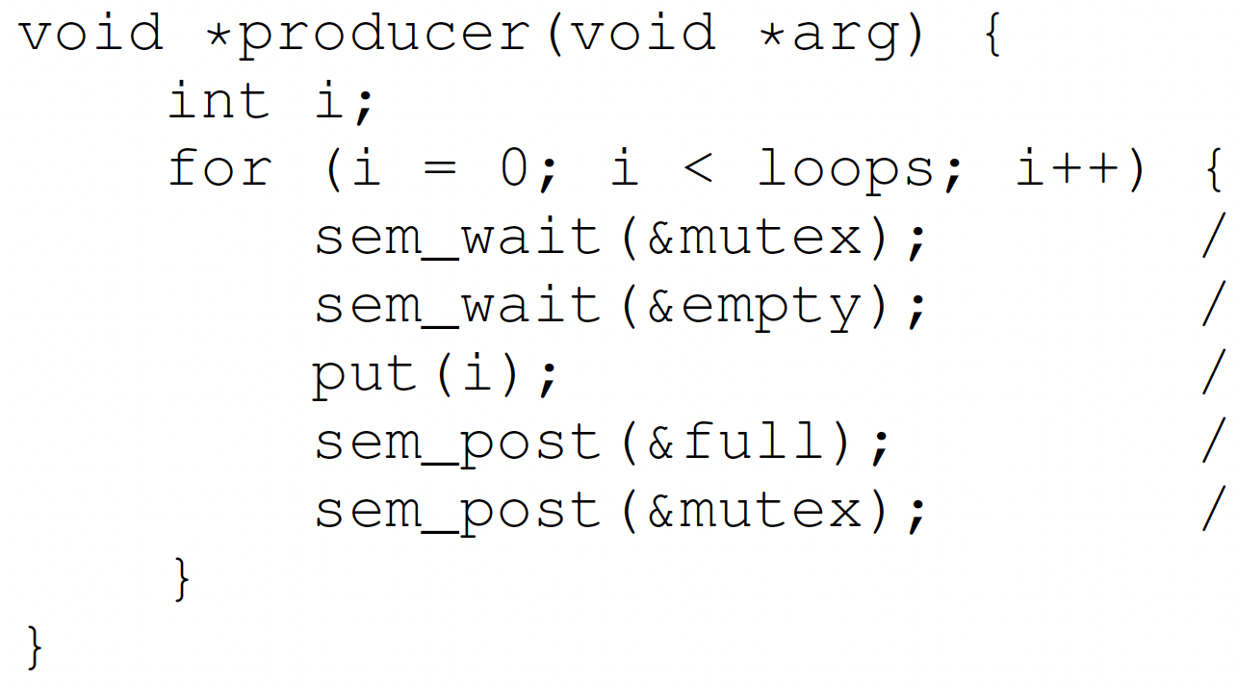
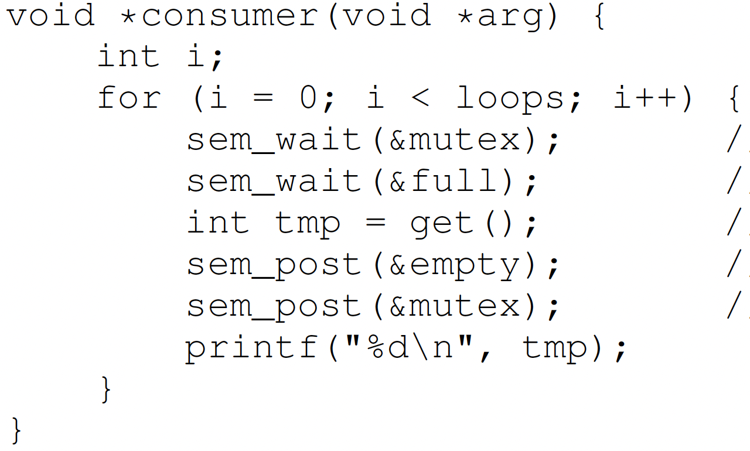
Semaphore for P/C – Mutex
mutex = 1
full = 0
empty = 10

Slide 20
Semaphore for P/C – Mutex
mutex = 0
full = 0
empty = 10
Ready
Wait for lock
Running
Hold lock
Wait for full

Slide 21
Semaphore for P/C – Mutex
mutex = 0
full = 0
empty = 10
Running
Wait for lock
Block
Hold lock
Wait for full

Slide 22
Deadlock
Definition: A set of threads are said to be in a deadlock state when every thread in the set is waiting for an event that can be caused only by another thread in the set
Resource 1
Held
Wanted
Thread 1
Thread 2
Resource 2
Held
Wanted

Slide 23
Conditions for Deadlock
Mutual exclusion
Threads claim exclusive control of resources that require e.g., a thread grabs a lock
Hold-and-wait
Threads hold resources allocated to them while waiting for additional resources
No preemption
Resources cannot be forcibly removed from threads that are holding them
Circular wait
There exists a circular chain of threads such that each holds one or more resources that are being requests by next thread in chain

Slide 24
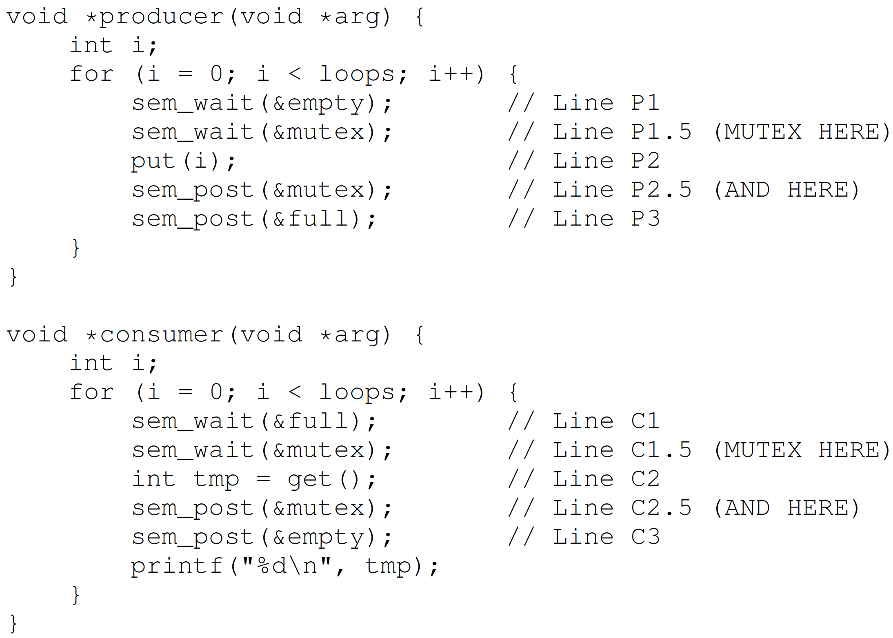
Mutex without Deadlock
Lock just around the critical section

Slide 25
Summary
Semaphores -> locks + condition variables
Binary semaphores -> locks
Semaphore for ordering
Semaphore for P/C

